Slide 1
Research Methods
Eliciting primary data
Dr Kevin McManus
Much of this presentation is copied from
Nayda G. Santiago, University of Puerto Rico

Slide 2
Outline
Introduction : projects and primary data
Research and the scientific method
Research approaches
Quantitative and qualitative approaches
Experiments
Sampling and reporting

Slide 3
What is a Project?
Jobs
Projects
Research
Routine
Uncertain
All require a sound understanding of the state-of-the-art acquired through investigation and reading
‘Jobs’ – repetition of very well-defined and well understood work with very little uncertainty
‘Research’ – exploration, e.g. finding a cure for cancer: the outcome is very uncertain
‘Projects’ – somewhere in the middle!
Hughes, B. and Cotterell, M. (2005) Software Project Management, McGraw Hill
Notes:
On the one hand there are repetitive jobs a similar task is carried out repeatedly, for example Kwikfit replacing a tyre on a car or a lecturer giving an introductory talk on project management. The task is well-defined and there is very little uncertainty. In some organizations, software development might tend to be like this – in these environments software process management might be more important than software project management
On the other hand some exploratory activities are very uncertain. Some research projects can be like this – we may not be sure what the outcome will be, but we hope that we will learn some things of importance. It may be very difficult to come up with precise plans, although we would probably have some idea of a general approach.
Projects seem to come somewhere between these two extremes. There are usually well-defined hoped-for outcomes but there are risks and uncertainties about achieving those outcomes.

Slide 4
Primary Data
Information observed or collected directly from first hand experience
Quantitative data
  how many, how much, how long
  numbers, integer or real (floating point)
  sets, tabular or graphical
Qualitative data
  data that cannot be measured
  thoughts, feelings, preferences
  not numerical
No hard boundary between these two
Flanagan, C. and McGee, J. (2014) EPQ Toolkit for AQA: A guide for students, Illuminate

Slide 5
Research is not...
Research is not information gathering
  collecting information from resources such journals, books or magazines is not research
  zero contribution to new knowledge
Research is not the transportation of facts
  moving facts from one resource to another does not constitute research
  no contribution to new knowledge
    although this might make existing knowledge more accessible
    starting point for metaresearch

Slide 6
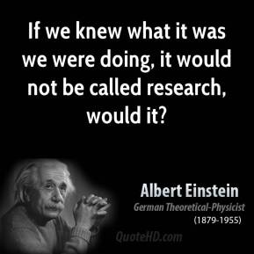
Research is...
“…the systematic process of collecting and analyzing information (data) in order to increase our understanding of the phenomenon about which we are concerned or interested.”
Leedy, P. D. and Ormrod, J. E. (2013) Practical Research: Planning and Design, 10th Edition, Pearson

Slide 7
Research Characteristics
Start with a question or problem
Requires clear articulation of a goal (aim, target)
Follows a specific plan or procedure
Often divides the main problem into subproblems
  SMART objectives
Accepts certain critical assumptions
Includes collection and interpretation of data

Slide 8
Hypothesis
From Greek meaning "to suppose"
A proposed explanation for a phenomenon
To be a scientific hypothesis it requires that one can test it using the scientific method
Hypotheses are often based on observations that cannot be explained with available scientific theories
Even though the words "hypothesis" and "theory" are often used synonymously, a hypothesis is not the same as a theory
Definition stolen from Wikipedia

Slide 9
Scientific Method
Hypothesis
Sequence of experiments
  randomization of subjects
  repetition
    to ensure that results are reproducible
      not just a happy accident
Altering one parameter in an experiment
  prove or disprove hypothesis
Document for others to reproduce
The Computer Scientific Method
Hunch
1 experiment & change all parameters
Discard if it doesn't support hunch
Why waste time?
  we know this already
Patterson, D. A. (2001) How to have a bad career in research/academia, UC Berkeley

Slide 10
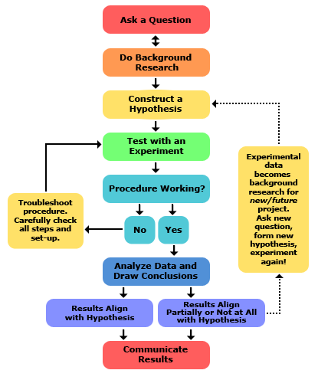
http://www.sciencebuddies.org/science-fair-projects/project_scientific_method.shtml

Slide 11
Literature Review
A literature review is a necessary first step
  without this step, you won’t know if your problem has been solved or what related research is already underway
When performing the review
  start searching professional journals
  begin with the most recent articles you can find
  keep track of relevant articles in a bibliography
  don’t be discouraged if work on the topic is already underway
    this often validates the research
You are already on the way to completing your first Literature Review
Jones, C and Jia, X (2010) Research Concepts http://www.fatih.edu.tr/~moktay/2011/ceng-bilm403/research.ppt
Notes:
Some journals include IEEE and ACM. Be careful of trade journals; they’re often not peer reviewed which can call the content into question in terms of its reliability and quality.
The bibliography could be a Word document, Excel spreadsheet, or bibliographic database. Even if the article doesn’t directly pertain to your current project, it might provide you with ideas.

Slide 12
Research Process
Research is an extremely cyclic process
  later stages may well require a review of earlier work
This isn’t a weakness of the process but is part of the built-in error correction machinery
Because of the cyclic nature of research, it can be difficult to determine where to start and when to stop
Jones, C and Jia, X (2010) Research Concepts http://www.fatih.edu.tr/~moktay/2011/ceng-bilm403/research.ppt
Notes:
We’ll try to give some guidelines as to how to choose starting and stopping points during your research work.
Please keep in mind that the following steps don’t have to be slavishly followed in the sequence in which they are presented.

Slide 13
Experiment
Demonstrate cause and effect
Independent variable (IV)
  altered by the experimenter
Dependent variable (DV)
  keeping all extraneous variables constant apart from the IV then any change in the DV must be caused by the IV

Slide 14
Experiment
Lab Experiment
  well controlled
  contrived environment
Field Experiment
  genuine environment
  poor control of extraneous variables
Natural (quasi) experiment
  variation in the IV occurs naturally
  inability to control IV variation

Slide 15
Sampling
Selecting participants in your study
  how to identify your population?
  potentially immense.
Use probability sampling to elicit responses from a representative subset
  random - lottery
    ideal but very difficult to achieve
  systematic - select every n^{th} from list
    not that different to random
  stratified – random or systematic subgroup sampling
    e.g. random female age 30-39
What if your samples decline to respond?
An all too often flawed process

Slide 16
Sampling
Nonprobability sampling accepts that the sample population is not necessarily representative
  convenience – a.k.a. known as opportunity or availability
    sample the first people you bump into
  self-selected – a.k.a. volunteer
    how did you recruit volunteers?
  quota – not unlike stratified but with convenience or self-selected sampling
    e.g. street interview adult males until you have 3 responses from 4 age ranges
  snowball - locating samples
    e.g. use social media to locate people with Windows smartphones
Open to significant bias
An all too often deeply flawed process

Slide 17
Self-reporting
Questionnaires and interviews allow subjects to describe their thoughts and feelings
  the truth of the response is unknown
A well designed questionnaire can be effective in eliciting accurate and representative responses
A poorly designed interview will return questionable results
Few questionnaires are well designed

Slide 18
Bad Questionnaires
Bad
  Do you like fruit and vegetables?
Better
  Do you like fruit?
  Do you like vegetables?
Better still
  Do you eat any of the following?
    apples
    oranges
    bananas

Slide 19
Better Questionnaire
How many of the following are you likely to eat in a month (circle appropriately)
  apples
    0 1 2 4 8 15 30
  oranges
    0 1 2 4 8 15 30
  bananas
    0 1 2 4 8 15 30

Slide 20
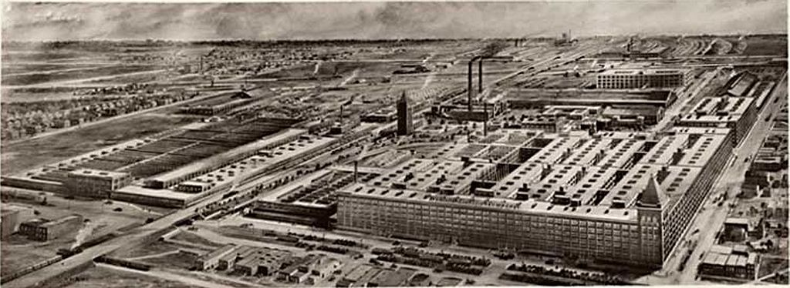
Observational
Covert or overt observation of the subject by the researcher
  avoids problems with false self –reporting
Hawthorne effect
  individuals modify (usually improve) an aspect of their behavior or their perception of a problem in response to their awareness of being observed
Landsberger, H. A. (1958) Hawthorne Revisited, Ithaca
McCarney, R. et al (2007) The Hawthorne Effect: a randomised, controlled trial, BMC Med Res Methodol , 7: 30

Slide 21
Research Ethics
Whatever sample group you choose you are required to
  obtain consent
  comply with the Data Protection Act (1998)
If your sample group is outside the university you will be required to complete a research ethics application
If your sample group includes minors or vulnerable adults you will require approval from the REC

Slide 22
Summary
Research provides primary data
  quantitative or qualitative
Scientific method to verify hypotheses
Experiments
  lab, field, natural
Sampling
  self-reporting and observational
  ethics

Slide 23

Any Questions?

